Slide 1

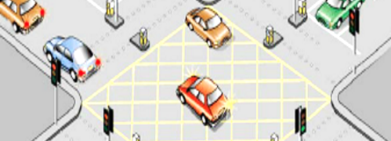
Traffic Prediction
Naveen Reddy Garlapati
LQ63734
Prepared for : UMBC
Data Science Master Degree Capstone by: Dr Chaojie(Jay) Wang

Slide 2
Problem Statement
The aim of this project is to derive insights from data analysis and then build a model/models that can be used to predict traffic at particular times at the different junctions in the city.
Problem Statement
The model should not take too long to return prediction
To minimize the Root Mean Squared Error (RMSE) as well finding (MAPE)Mean Absolute Percentage Error
To check if model is overfitting with stratified cross validation.
Objectives

Slide 3




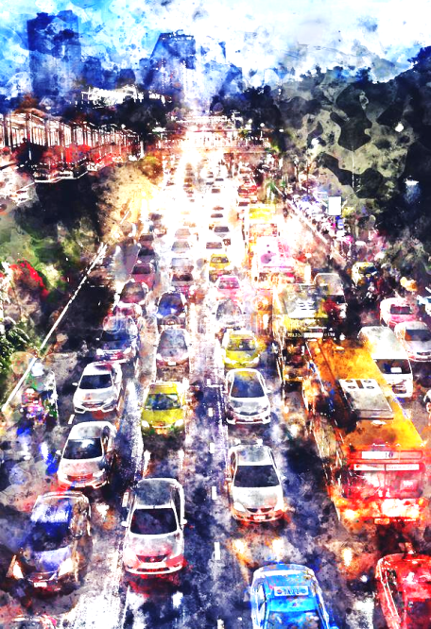


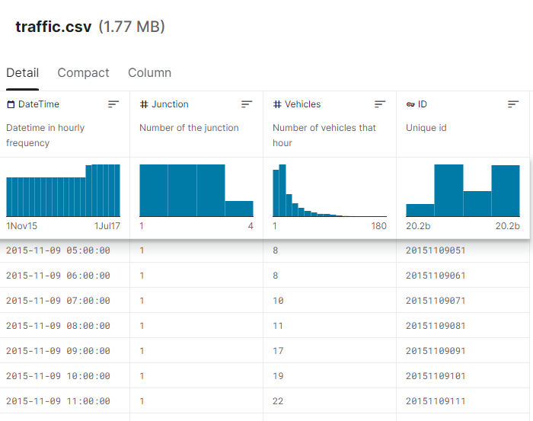


DataSet Description
Features
Collection
A CSV file with
Number of Instances: 48120
Number of Attributes: 4
The data was collected in between 2015-2017 at different time periods in a day
Data Source
Data Quality
https://www.kaggle.com/datasets/fedesoriano/traffic-prediction-dataset
Some of the junctions have provided limited or sparse data, E.g.-4th junction

Slide 4



Model Evaluation and tuning
Feature Extraction and Engg.
Step-1
Extracting new features for the DateTime Column
Tuning hyperparameters for the chosen model(LGBM) and checking feature importance to get rid of unimportant features
Step- 4
Step-2
Step- 3
Feature Scaling and selection
Modeling
Building Baseline Model with the best performing Models (CatBoost, LGBM, RandomForest, and XGBoost later checking for overfitting using stratified cross validation(SCV) to choose the best model.
Using Target Encoding to create new features such as {Junction, ID, Year, Month, day_of_month, day_of_week, Date, Time, day_of_year} with aggregates: Std, Max, Min, Mean and Median.
Reiterating to get best results

Slide 5
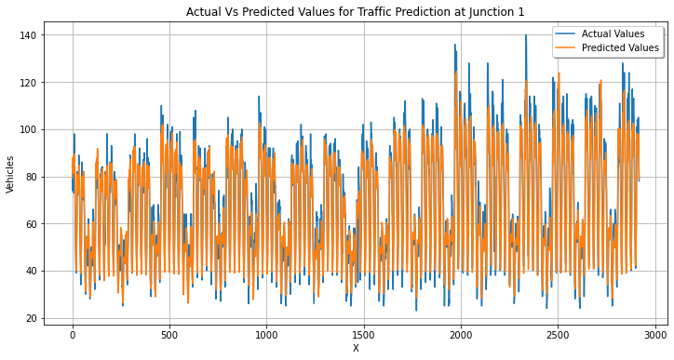
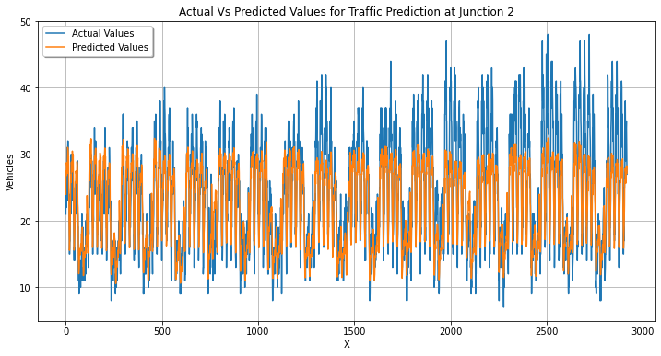
Modelling
Separated the Dataset into 4 for each junction and then applied different models to find the best among.
The datasets was trained and tested on different models out of which some are XgBoost, prophet, Ridge, Lasso, ARIMA, LGBM.

Slide 6
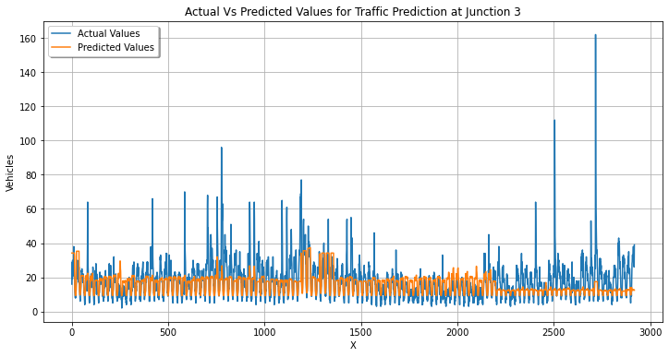
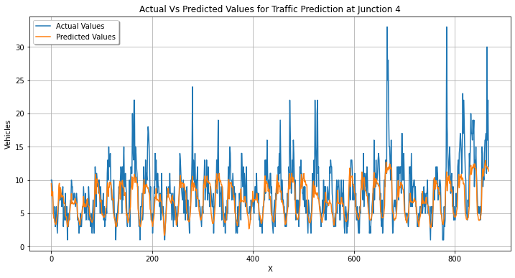

The LGBM model's work on the actual vs. predicted depends on the values of RMSE and MAPE. To enhance the performance remodeling was done after feature selection.
Light GBM is sensitive to overfitting and can easily overfit small data hence I used cross validation to prevent it.
LGBM(Light Gradient Boosting Machine)

Slide 7
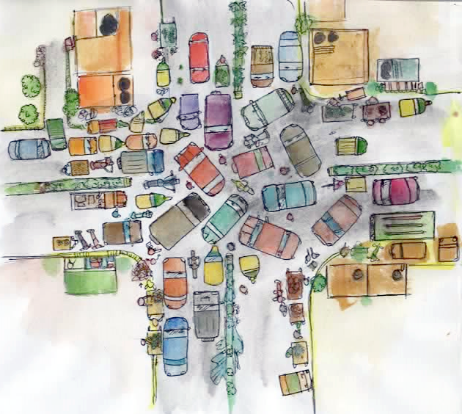
Deployment
Click!!

Slide 8
Thank you!

